Slide 1

Synthetic Data Bridging Privacy and Regulation
Presented by,
V. V. Sreejish

Slide 2





Every day, the world generates 463 exabytes of data [IDC, 2024].
463 Exabytes/day = 19,000 photos (3 MB each) for every person on Earth, every day

Slide 3

The three W’s of Synthetic data, What it is , Why it matters and Where it is making impact.
What is Synthetic Data?
Synthetic data is artificially generated data that mirrors the statistical properties of real-world data. So, is it Fake, NO!
“everything like the original - minus the risk”

Slide 4
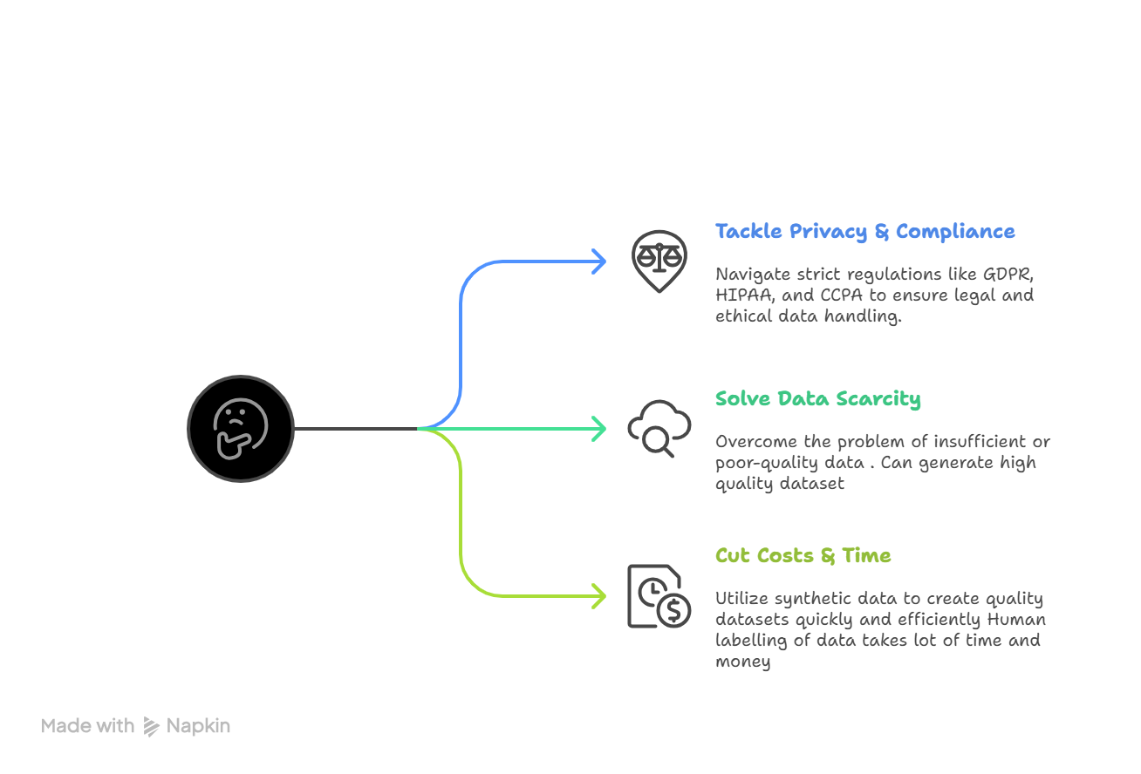
The three W’s of Synthetic data, What it is , Why it matters and Where it is making impact.
Why it matters more than ever?

Slide 5





The three W’s of Synthetic data, What it is , Why it matters and Where it is making impact.
Where Synthetic Data Is Powering AI Innovation?

Slide 6
According to Gartner report: Synthetic Data Will play a key role in AI Systems by 2030

Slide 7
How To Generate Synthetic Data
Traditional / Statistical – Generate data using rules, probability distributions, or templates. Best for simple tabular datasets.
Machine Learning-Based – Use models like GANs, VAEs, or diffusion models to produce realistic structured or unstructured data.
Agentic / Autonomous AI – AI agents generate data adaptively through environment interaction and feedback, ideal for edge cases and simulations.

Slide 8
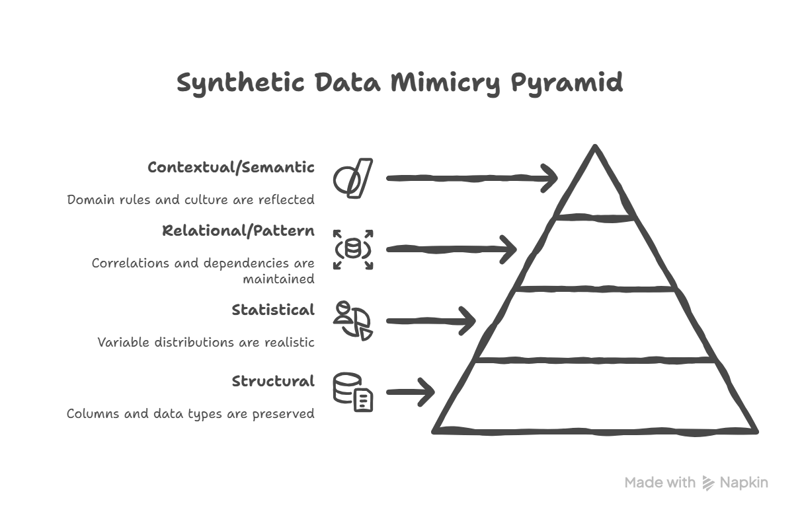
Realism Check

Slide 9
Levels of Realism in Synthetic Data
Level | What is Preserved | Example / Use
Structural | Columns, data types, value ranges | Columns exist, salary numeric, region categorical
Statistical | Distributions of variables | Salary distribution skewed, regional counts realistic
Relational / Pattern | Correlations & dependencies | Higher salary → higher expenses; conditional relationships
Contextual / Semantic | Domain rules, cultural plausibility | Student → lower salary; demographics match region/language

